Slide 1

VELAMMAL COLLEGE OF ENGINEERING AND TECHNOLOGY
FINAL REVIEW PRESENTATION
TITLE Distributed Generation System Using Hybrid Renewable Energy Sources.
Presented By
Hrithik Vel .B (913119105022)
Jey vishnu V.BA(913119105028)
Vijay Krishna T.K.B (913119105304)
Guided By : Dr.S.Chellam M.E,Ph.D AP III/Dept of EEE, VCET
Date : 19.05.2023 Friday.

Slide 2
Abstract
A new, hybrid integrated topology, fed by photovoltaic cell (PV), wind energy and fuel cell (FC) sources suitable for distributed generation applications, is proposed. It works as an uninterruptible power source that is able to feed a certain minimum amount of power into the grid under all conditions.
Photovoltaic source is utilized as the main power and runs very near to its Maximum Power Point, while the fuel cell section serves merely as a DC supply and feeds just the power that is needed to make up the difference. The integrated approach improves the overall power level that is supplied because of the presence of the fuel cell and wind energy in parallel with the photovoltaic source.

Slide 3
Introduction
Hybrid power systems are those that generate electricity from two or more sources, usually renewable, sharing a single connection point. Although the addition of powers of hybrid generation.
The integration of different types of energy sources(non conventional energy sources) into a Distributed Generation system is called a hybrid distributed generation system (HDGS).

Slide 4
LITERATURE SURVEY
S.NO | JOURNAL PAPER | AUTHOR | TITLE | DESCRIPTION
1 | IEEE TRANSACTIONS ON ENERGY CONVERSION, VOL. 23, NO. 2. (JUNE 2008) | Sachin Jain and Vivek Agarwal, Senior Member, IEEE | An Integrated Hybrid Power Supply for Distributed Generation Applications Fed by Nonconventional Energy Sources | This hybrid integrated topology, fed by photovoltaic (PV) and fuel cell (FC) sources and suitable for distributed generation applications, is proposed. It works as an uninterruptible power source that is able to feed a certain minimum amount of power into the grid under all conditions.
2 | International Journal of Mechanical Engineering. (JULY 2022) | N.V.KISHORE KUMAR 1, K. KRISHNA REDDY 2, S .R.RAMYA 3, P.ASWINI 4, CR.PAVAN KUMAR 5, P.INDIRA 6, S.DIVYASREE | AN INTEGRATED HYBRID POWER SUPPLY FOR DISTRIBUTED GENERATION APPLICATIONS FED BY NON CONVENTIONAL ENERGY SOURCES | The proposed management system is designed to manage the power flow between the hybrid power system in order to satisfy the load requirements based on artificial neural network (ANN) and fuzzy logic controllers.
3 | Journal of Electrical Engineering and Automation (ISSN: 2582-3051) (SEPTEMBER 2022) | S. Kayalvizhi1*, K. Senthil Kumar2, M. Sindu3, S. Muminthaj. | Hybrid Cascaded Inverter-Based Integrated Hybrid Power Supply Using Nonconventional Energy Sources | The Photovoltaic and Fuel Cell source are used to power the hybrid integrated topology's power supply. Photovoltaic source is utilized as the main power and runs very near to its Maximum Power Point, while the fuel cell section serves merely as a DC supply and feeds just the power that is needed to make up the difference.

Slide 5
EXISTING SYSTEM
Among the earlier work have proposed an HDGS configuration. It consists of two inverters, operating in parallel, whose outputs are tied to the grid through a single, multi winding, step-up transformer.
The drawback with this otherwise elegant scheme is that it does not utilize the available sources efficiently as maximum power point tracking (MPPT) is not implemented.
Existing configuration uses an H-bridge inverter topology for interfacing with the grid, which either needs a line frequency bulky transformer at the output or high dc link voltage at the inverter input.

Slide 6
Problem Identification
One of the problems with this system is that, at very low insolation levels, the PV side dc–dc converter must be cut off to prevent its inefficient operation. Thus, at small power levels, generation by the PV source remains unutilized. This may be acceptable for high power applications, but could be a matter of concern for residential or medium-power installation.If the function of the PV side dc–dc converter is merged with the inversion stage, even a small fraction of power generated during low insolation can be utilized.

Slide 7
PROPOSED SYSYTEM
In the proposed system MPPT is implemented.
The proposed system uses an inverter with boosting capability, which eliminates the requirement of high dc voltage at the inverter input, thereby saving the cost of high-voltage buffer capacitor.
Harmonics reduction is improved.
Voltage and current reference control are implemented.
DC grid control is proposed.

Slide 8
Block Diagram
WIND TURBINE
GRID
DC/DC BUCK CONVERTER
INVERTER(BOOSTING+MPPT+INVERSION)
PV ARRAY
DC/DC BUCK BOOST CONVERTER
FUEL CELL

Slide 9
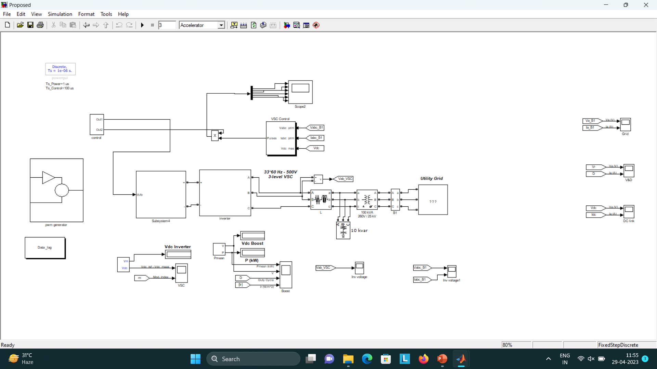
SIMULINK DIAGRAM

Slide 10
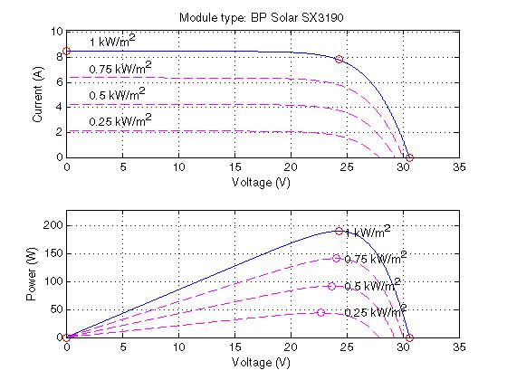
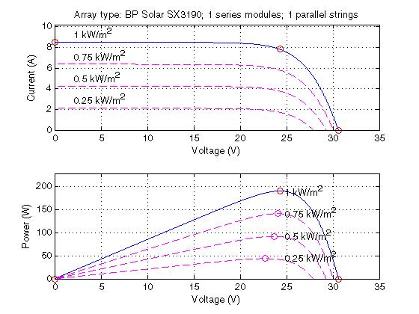
Figure shows the PV panel properties in V-I and P-V curve used in simulating the proposed work.
Figure shows the characteristics of single module in I-V and P-V curve of the simulated panel

Slide 11
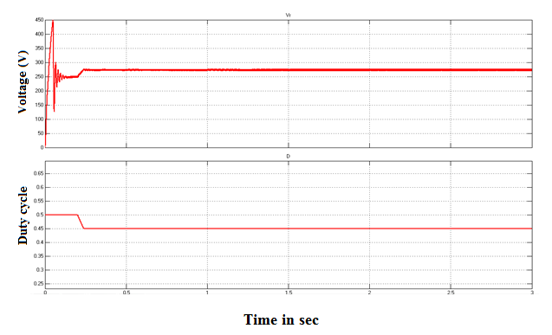
Figure shows the Changes in rectifier output voltage and duty cycle of boost converter.

Slide 12
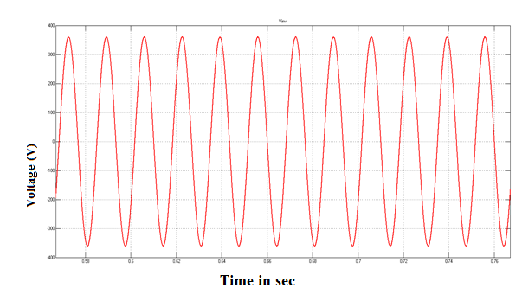
Inverter output voltage
Figure shows depicts the inverter voltage which is the output of inverter converted from DC to AC. The converted AC voltage is filtered for harmonics reduction and then it is synchronized into the grid.

Slide 13
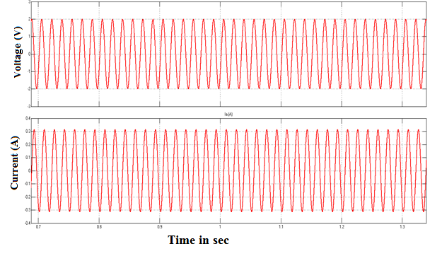
Steady-state grid voltage and current waveforms
The current was delivered to the grid by the inverter at unity power factor. Grid voltage and current of the proposed grid connected system represents the voltage and current are maintained as inline by the controller 2 and this shown in the above figure.

Slide 14
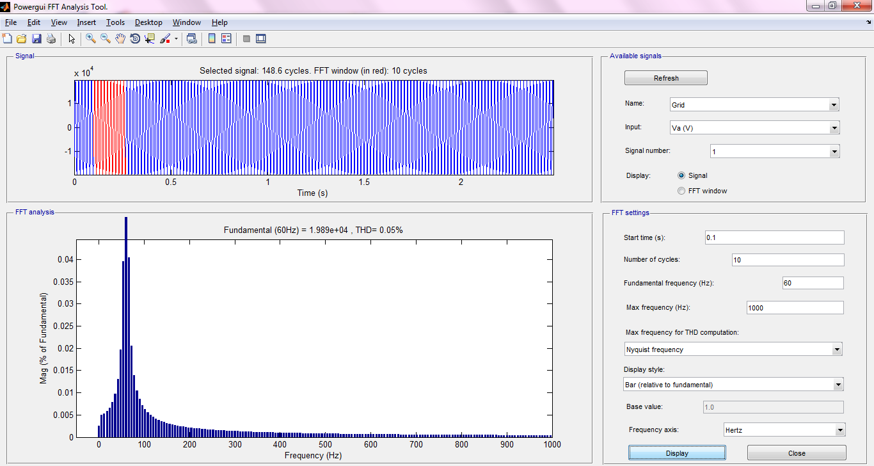
Harmonic analysis of grid voltage
Figure show the harmonics of output voltage find through FFT analysis. It has 0.05%.

Slide 15

Harmonic analysis of grid current
The total harmonic distortion (THD) of the voltage and the current at grid side were measured by using FFT analyzer and the results are shown in above Figure.

Slide 16
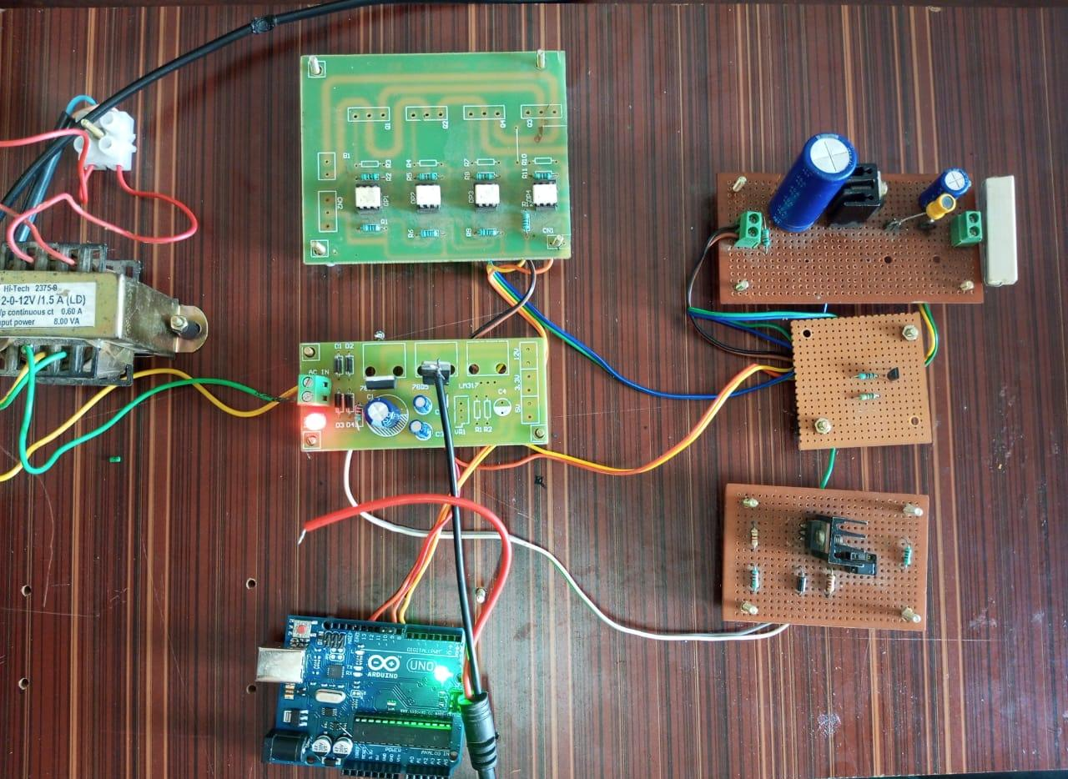
HARDWARE KIT

Slide 17
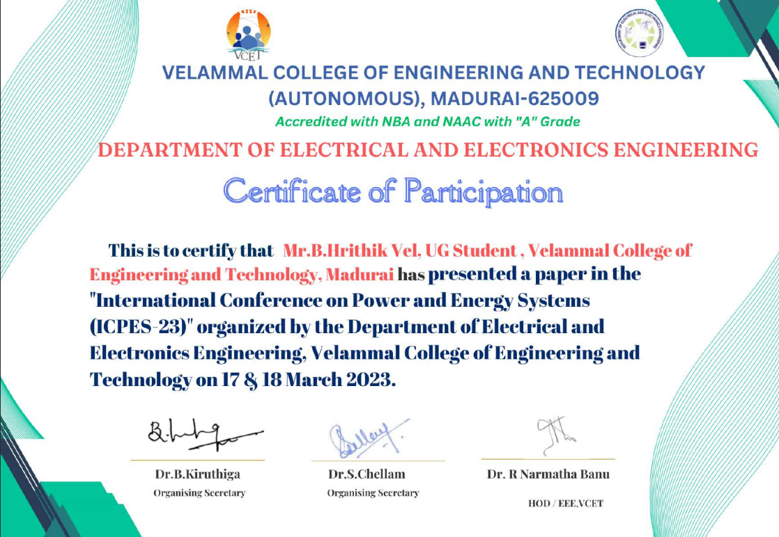
JOURNAL PUBLICATIONS
CONFERENCE–Participated in “International Conference On Power And Energy Systems-ICPES 23” at Velammal College Of
Engineering And Technology.
2. PUBLICATION-Applied for publication In Scope Journal “Hrithik vel B, Jey vishnu V Ba, Vijay krishna TKB, Dr. S.Chellam Distributed Generation System Using Hybrid Renewable Energy Sources.

Slide 18
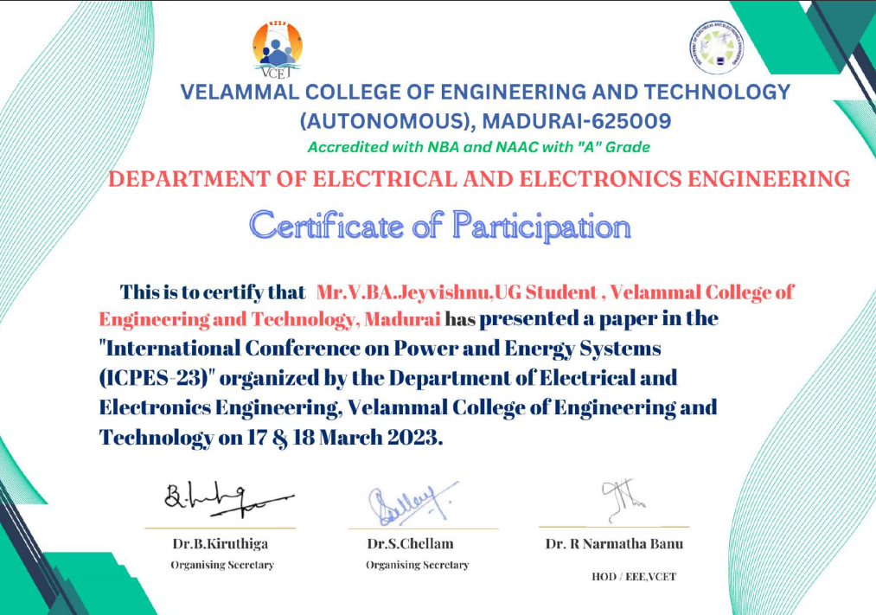
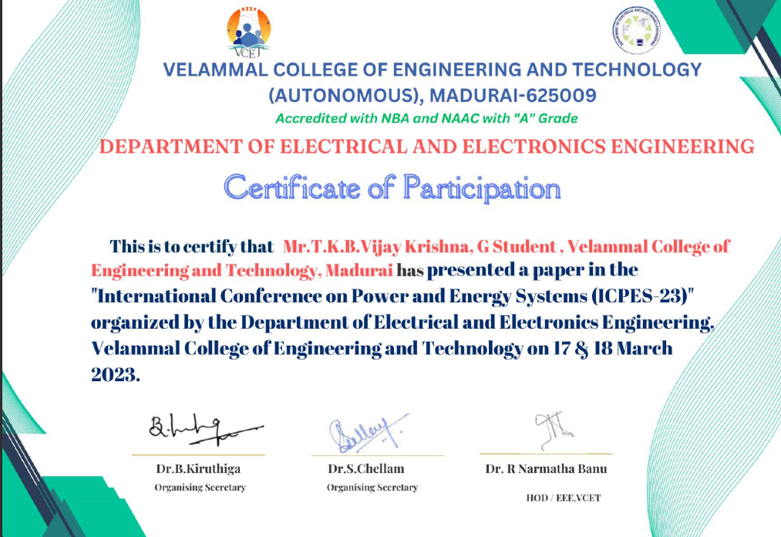

Slide 19
References
[1] Sachin Jain and Vivek Agarwal, Senior Member, IEEE-An Integrated Hybrid Power Supply for Distributed Generation Applications Fed by Nonconventional Energy Sources-June 2008.
[2]N.V.Kishore Kumar and K.KrishnaReddy-An Integrated Hybrid Power Supply For Distributed Generations Applications Fed By Non Conventional Energy Sources-PP.0974-5823-Volume:07 Issue:07-july 2022.
[3]S.Kayalvizhi and K Senthil Kumar-Hybrid Cascaded Inverter Based Integrated Hybrid Power Supply Using No convention Energy Sources-PP.2582-3051-Volume:04 Issue:-Sep-2022.
[4] N. Kato, K. Kurozumi, N. Susuld, and S. Muroyama, “Hybrid powersupply system composed of photovoltaic and fuel-cell systems,” in Telecommun. Energy Conf., Jpn, Oct., 2001, pp. 631–635.
[5] K. Rajashekara, “Hybrid fuel-cell strategies for clean power generation,” IEEE Trans. Ind. Appl., vol. 41, no. 3, pp. 682–689, May/Jun. 2005.

Slide 20
[6]Barklund, E., Pogaku, N., Prodanovic, M., Hernandez-Aramburo, C., and Green, T. C., “Energy management in autonomous micro-grid using stability-constrained droop control of inverters,” IEEE Trans. Power Electron., Vol. 23, p. 2346, 2016.
[7]Bollen, M., Zhong, J., Samuelsson, O., and Bjoernstedt, J., “Performance indicators for microgrids during grid-connected and island operation,” IEEE Bucharest Powertech, Vol. 1–5, pp. 866–871, 2017.
[8]Brissette, Alexander, et al. "A micro-grid modeling and simulation platform for system evaluation on a range of time scales." In Proc. Energy Conversion Congress and Exposition (ECCE), 2011 IEEE. IEEE, 2014.
[9]Chen, Weiqiang, Ali M. Bazzi, James Hare, and Shalabh Gupta. "Real-time integrated model of a micro-grid with distributed clean energy generators and their power electronics." In 2015 IEEE Applied Power Electronics Conference and Exposition (APEC), pp. 2666-2672. IEEE, 2015.
[10]Chung, I., Park, S., Kim, H., Moon, S., Han, B., Kim, J., and Hoi, J., “Operating strategy and control scheme of premium power supply interconnected with electric power systems,” IEEE Trans. Power Delivery, Vol. 20, No. 3, pp. 2281–2288, July 2018.

Slide 21
11.Guerrero, J. M., Hang, L., and Uceda, J., “Control of distributed uninterruptible power supply systems,” IEEE Trans. Indust. Electron., Vol. 55, No. 8, pp. 2845–2859, August 2017.
12.Hao, J., Chen, C., Libao, S., and Jie, W., “Nonlinear decentralized disturbance attenuation excitation control for power systems with nonlinear loads based on the Hamiltonian theory,” IEEE Trans. Energy Conversion, Vol. 22, No. 2, pp. 316–324, 2015.
13.Hatziargyriou, N., Asano, H., Iravani, R., and Marnay, C., “Microgrids,” IEEE Power Energy Mag., Vol. 5, No. 4, pp. 78–94, July/August 2018.
14.Hoke, A. Brissette, K. Smith, A. Pratt, D. Maksimovic, "Electric Vehicle Charge Optimization Including Effects of Lithium-Ion Battery Degradation," 2011 IEEE Vehicle Power and Propultion Conference, Chicago, IL, 6-9 Sept. 2012.
15.Katiraei, F., and Iravani, M. R., “Micro-grid autonomous operation during and subsequent to islanding process,” IEEE Trans. Power Delivery, Vol. 20, No. 1, pp. 248–257, January 2019.

Slide 22
THANK YOU

